Slide 1

Lowering the No-Show Rates of Clinical Appointments
Through Patient Identification and
Targeted Text Reminder Intervention
Team 3: Eleanor Lee, Yifei Ren, Howard Wang, Julie Wang

Slide 2
Agenda
Business Understanding
Data Understanding
Data Preparation
Modeling – Classification Model
Modeling – Recommender System
Evaluation
Deployment

Slide 3

Business Understanding： Current Situation
A doctor's time can be analogous to revenue
The average cost of a 15-minute doctor's appointment: $104
A doctor at a clinic can see on average, 32 patients a day = $3,328 in revenue
Healthcare industry is worth a lot, and growing
Expected to be worth $6 trillion by 2027
Each person will spend about $11,172, which is about 17.7% of GDP
When patients miss appointments, revenue is lost, and valuable slots are taken away from walk-in patients

Slide 4

Business Understanding: Previous Studies
Johns Hopkins
Assigned no-show scores to patients to identify high-risk patients
Found patients who frequented emergency rooms, were also more likely to miss scheduled appointments
Duke
Helped care sites to operate more efficiently and maximize the use of clinician hours
Found that clinic-level models had a higher accuracy, and higher recall
International Journal of Pediatrics
Found that people who were texted, were 2x more likely to show up, or at least would call to cancel or reschedule
Patients who used online portals to schedule were less likely to mis appointments

Slide 5


Our Goals
To identify no-show patients
Binary classification models
Allows clinics to know who to text, and if they can reassign a doctor's time to a walk-in patient
To increase effective outreach
Recommender System
After identifying high-risk, no-show patients, recommend patients to text that will help increase show rate
Why not just text everyone?
Automated Texts != HIPAA Compliant
Manual texts are required
Takes a lot of time

Slide 6

Data Understanding
Variable Name | Type | Description/Purpose
PatientId | Integer | Identification of a Patient
AppointmentID | Integer | Identification of each Appointment
Gender | Categorical | Gender of the Patient
ScheduledDay | Datetime | Day/Time someone called or registered the appointment
AppointmentDay | Date | Day of the Actual Appointment
Age | Integer | How old is the patient
Neighbourhood | Categorical | Where the Appointment takes Place (e.g. where the clinic is located)
Scholarship | Binary | Whether the patient is a part of the Brazilian social welfare
Hipertension | Binary | Whether the patient has abnormally high blood pressure
Diabetes | Binary | Whether the patient has diabetes
Alcoholism | Binary | Whether the patient has alcoholism
Handcap | Binary | Whether the patient has a handicap
SMS_recieved | Binary | 1 or more messages was sent to this patient
No-show | Categorical | Is the patient a no-show
From
Appointment level data from various clinics in Brazil
110, 527 appointments, across 62, 299 patients
14 Variables – 13 features, 1 target
Scheduled on November 2015-June 2016
Appointments on April 2016-June 2016
Notes:
Our data comes from Kaggle in a csv form. It contains appointment data from various Brazilian clinics. There are a total of 110,527 observations(appointments) of 14 variables (13 features and the target variable) scheduled between November 2015 and June 2016, and appointment dates between April 2016 and June 2016.

Slide 7
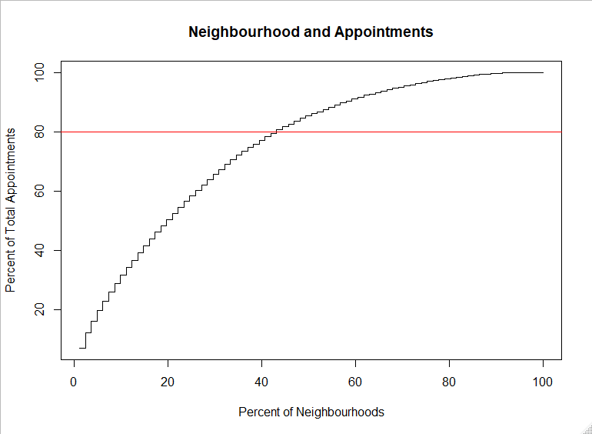
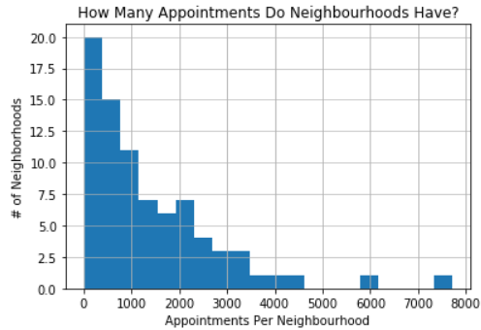
Data Understanding
80% of appointments occurred in 40% of the neighborhoods
81 neighborhoods, no information at clinic level
Most neighborhoods had less than 1000
The busiest is Jardim Camburi with 7717
The least busy is Parque Industrial with 1

Slide 8
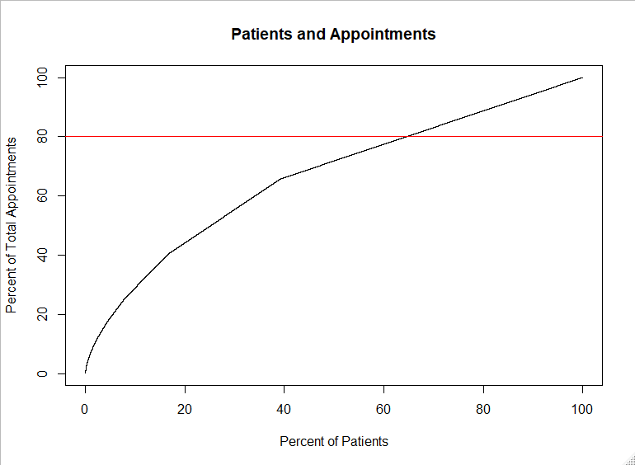

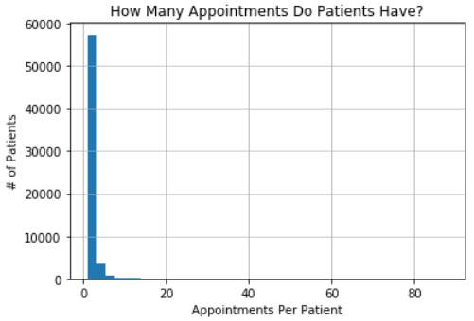


Data Understanding
80% of appointments held by 65% of patients
Age: min = -1, max = 115, mean = 35
Ages from 10-30, have a dip in number of appointments
Gradual tail at upper range
Of Appointments
9.83% on scholarship
19.72% have Hypertension
7.19% have Diabetes
3.04% have Alcoholism
1.85% have a Handicap
65% are from female patients
27.6% received SMS reminders
Less likely to show, why?
Ineffective outreach method, casting a wide net
No-show rate is 20.19%

Slide 9
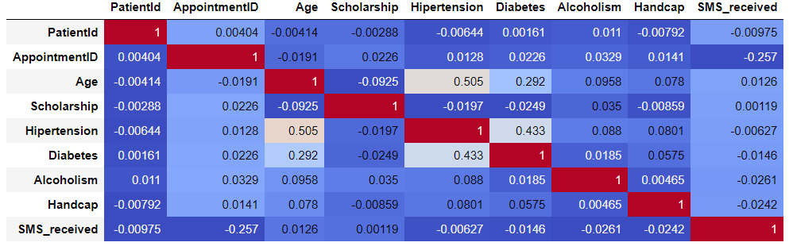
Data Understanding
No multicollinearity
Based on no-show rates for each features' values, some important features may be
Scholarship
Hipertension
Diabetes
Handcap

Slide 10

Data Preparation: Cleaning
Removed –1 Age
Removed Handicap = 2,3,4
Change Datetime format to 'Y-M-D'
Removed where ScheduledDay happened after AppointmentDay
Made decisions related to children appointments
Can children 'receive' text messages
Assume if true, the guardian that will bring them to the clinic is the one that receives it
Children were marked at alcoholic
Brazilian Psychiatry journal says mean age is 14
Removed observations were children were below 10 and alcoholics

Slide 11
Data Preparation: Feature Engineering
Variable Name | Description & Calculation
Lead_Time (Integer) | Difference between ScheduledDay and AppointmentDay
Scheduled_Weekday (Binary) | Whether the scheduling was done a weekday or not
Appt_Mon (Binary) | Whether the appointment is on Monday
Appt_Tues (Binary) | Whether the appointment is on Tuesday
Appt_Weds (Binary) | Whether the appointment is on Wednesday
Appt_Thurs (Binary) | Whether the appointment is on Thursday
Appt_Fri (Binary) | Whether the appointment is on Friday
Appt_Sat (Binary) | Whether the appointment is on a Saturday
Appt_Sun (Binary) | Whether the appointment is on a Sunday
Neigh_No-show_Percentage (Float64) | The No-Show rate at that particular clinic
Created Features related to
Time
Day of Week
Weekday vs Weekend
No-show Percentage in that neighborhood

Slide 12


Data Preparation: Encoding
Gender
Neighborhood
One Hot Encoding, with dropping the original column
For encoding clinics
Encode 33 busiest and ‘Other’
34 total columns
Will be informative, but not increase dimensionality of dataset as much

Slide 13
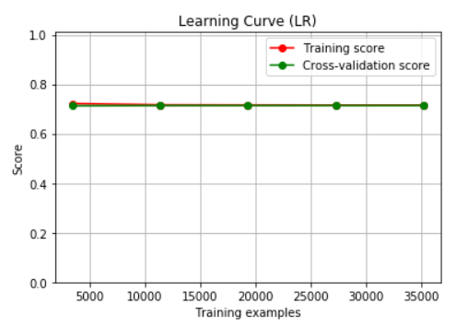
Modeling: Classification
Preparation:
Rebalancing Data
Normalizing Features
Parameter Optimization

Slide 14
Modeling: Classification
Model | Pros | Cons
Decision Tree | - Easy to implement - Intuitive to explain | - Creates deep, unbalanced trees due to one-hot encoding
Logistic Regression | - Provides probabilities, so that a cutoff can be implemented -Works well with diagonal decision boundaries | -High bias
kNN | -No assumptions about data -Easy to understand and explain | -Lazy algorithm; time consuming -Computationally expensive
SVM | -Performs well with linear and non-linear boundaries depending on the kernel used -Handles high dimensional data well | -Susceptible to overfitting issues based on kernel
CatBoost | -Learns sequentially and builds off previous trees -Can handle categorical features well | -Can overfit if trees is too large
Model Comparison

Slide 15
Modeling: Classification
Results
Model | Precision | Recall | Accuracy | AUC | Additional Notes
Decision Tree | .34 | .36 | .62 | .54
Logistic Regression | .34 | .57 | .57 | .59
kNN | .36 | .3 | .65 | .57
SVM | .34 | .59 | .56 | .57
CatBoost | .71 | .90 | .86 | .87 | Used non-normalized and unbalanced training set
Decision Tree, Logistic Regression, and SVM performed similarly on precision
Logistic Regression performed much better with the recall
Since SVM is using a linear kernel, not surprising to see it performs almost identically to Logistic Regression
The best model is the CatBoost model
Identify about 90% of no-show patients with a 71% precision
Allowing clinics to identify most of their patients that will be no-shows without misidentifying too many patients that would be shows
This high precision will allow clinics to focus their resources and outreach methods wisely and to greater, measurable effect

Slide 16
Modeling: Classification
Feature | Weight
Age | 30.001647
Lead_Time | 24.334057
Neigh_No-Show_Percentage | 15.588332
SMS_received | 11.548552
Scholarship | 5.9321338
is_Male | 3.3797398
Appt_Weds | 3.3304383
Appt_Mon | 2.2301275
is_ITARARÉ | 1.291575
is_ILHA_DO_PRÍNCIPE | 0.793934
is_NOVA_PALESTINA | 0.512376
Appt_Tues | 0.425326
is_DA_PENHA | 0.404885
Scheduled_Weekday | 0.216260
Appt_Sat | 0.010610
Feature Importance
Age is most important feature
Expectations from Data Understanding proven to be right: Scholarship & is_Male
4 neighborhoods appear here
Surprising how much day of week is important
People miss beginning half of the week and Saturday more
Whether you schedule on the weekday or weekend could lead to forgetting the appointment

Slide 17
Modeling: Transition
Preparing data from classification
Assigned each appointment to a group
Predicted No-Show and No Text, Predicted Show and Text, and Other
Preparing data for recommender
Cosine similarity is subject to the variance across different features
Normalize some of our continuous variables such as age and lead time, to (0,1) scale, and then use with encoded variables to calculate cosine similarity
Goal of the Recommender System
The final goal of the recommender system is to identify the appointments that we predict to be no-show but have a high likelihood of showing up if we send a text reminder to the patient involved based on similarity to patients who were texted and showed up

Slide 18
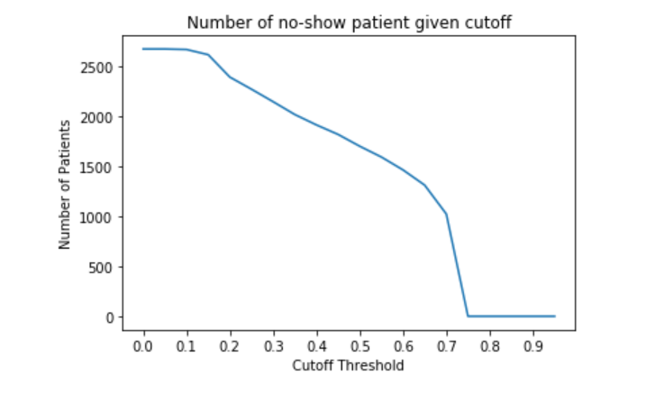
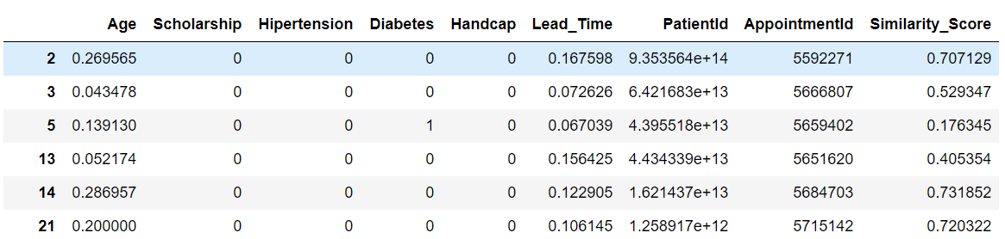
Modeling: Recommender System
Similarity Measure
‘Rating’ we use here to construct similarity measures is the attribute a person possesses
Construct cosine similarity on top of features such as whether a patient has hypertension, diabetes, or alcoholism.
More common attributes that two patients share, the higher the cosine similarity they will have.
Recommendation Result
The product is a list of appointments that we feel like the patient involved will likely convert from no show to show up if we send out a text reminder
Based on different cutoff values, we can filter the list of appointments and adjust the number of patients we contact.

Slide 19
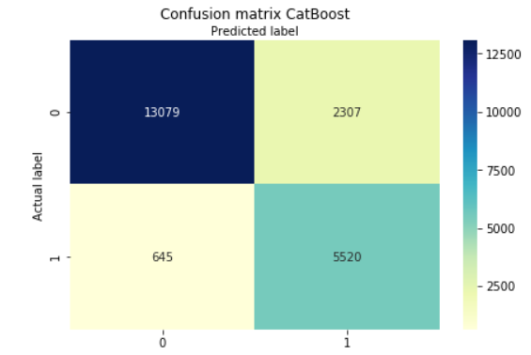
Evaluation: Classification
Profit Recovered from Patients Predicted to be No-Shows Correctly | 5520 * .5 * ($104 - $0.005) = $287,026.20
Costs of Contacting Patients that were Show (Predicted No-Show incorrectly) | 2307 * $0.005 = $11.54
Costs of Contacting No-show Patients that still are No-Show | 5520 * .5 * .005 = $13.80
$287,026.20 - $11.54 - $13.80 - $0.70 = $287,000.16 regained profit
$287,000.16/($104 * 5520) = 50% recovery
Key Assumptions
Conversion rate = 50%
$0.35 per phone line per month
$0.005 per outbound text message
$104 as measure of revenue
This is across 2 months of data

Slide 20
Evaluation: Recommender System
.3 cutoff
.5 cutoff
.7 cutoff
Profit Recovered from Patients Predicted to be No-Shows Correctly | 249 * .6 * ($104 - $0.005) = $15,536.85
Costs of Contacting Patients that were Show (Predicted No-Show incorrectly) | 364* $0.005 = $1.82
Costs of Contacting No-show Patients that still are No-Show | 249* .4 * .005 = $0.59
Profit Recovered from Patients Predicted to be No-Shows Correctly | 198* .6 * ($104 - $0.005) = $12,354.61
Costs of Contacting Patients that were Show (Predicted No-Show incorrectly) | 296* $0.005 = $1.48
Costs of Contacting No-show Patients that still are No-Show | 198* .4 * .005 = $0.40
Profit Recovered from Patients Predicted to be No-Shows Correctly | 249 * .6 * ($104 - $0.005) = $15,536.85
Costs of Contacting Patients that were Show (Predicted No-Show incorrectly) | 364* $0.005 = $1.82
Costs of Contacting No-show Patients that still are No-Show | 249* .4 * .005 = $0.59
$15,536.85 - $1.82 - $0.59 - $0.70 = $15,533.743 regained profit
$12,354.61 - $1.48 - $0.40 - $0.70 = $12,345.73 regained profit
$6,364.61 - $0.82 - $0.20 - $0.70 = $6,362.89 regained profit
$15,533.743 /($104 *249) = 60% recovery
$12,354.61 /($104 *198) = 60% recovery
$6,362.89/($104 * 102) = 60% recovery
Key Assumptions
Conversion rate = 60%
$0.35 per phone line per month
$0.005 per outbound text message
$104 as measure of revenue
This is across 2 months of data

Slide 21
Evaluation: Conclusion
Tradeoff between Money & Labor/Time
Classification
Recommender System
Highest total profit regained at $287k
Highest return on outreach effort at 60% across all cutoffs
Is the best way to encourage all patients to show up
Best way to reach the X most likely patients that will respond best to intervention
But, due to HIPAA, may not be feasible
Can control the costs of labor
Time cost of labor
5520 text messages over the two months
Leading to more effective outreach

Slide 22
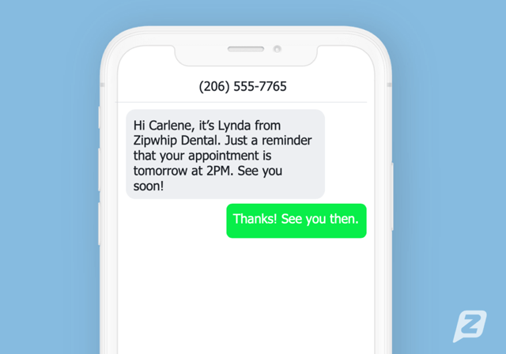
Deployment & Next Steps
Step1
Step2
Step3
Send out text reminders to the patients that we believe will convert
Predict the likelihood an appointment will convert to show if a text reminder is sent
Predict periodically the appointments that will likely to be a no-show.
Risk Analysis:
No ethical problem involved
Patient information needs to be protected (phone number, demographic information, reason of visiting, etc.)
Remain HIPAA compliant

